Slide 1
Data Analytics Life Cycle

Slide 2
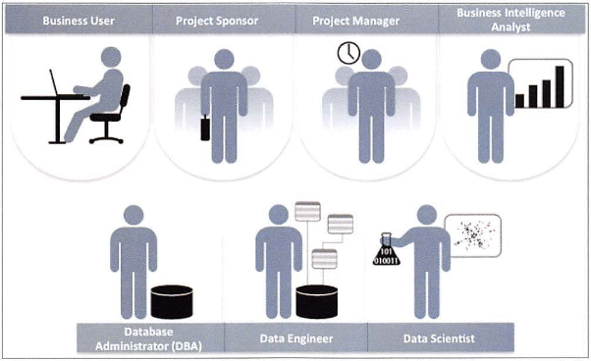
2.1.1 Key Roles for a Successful Analytics Project

Slide 3
Key Roles for a Successful Analytics Project
Business User – understands the domain area
Project Sponsor – provides requirements
Project Manager – ensures meeting objectives
Business Intelligence Analyst – provides business domain expertise based on deep understanding of the data
Database Administrator (DBA) – creates DB environment
Data Engineer – provides technical skills, assists data management and extraction, supports analytic sandbox
Data Scientist – provides analytic techniques and modeling

Slide 4
Data Analytics Lifecycle: Overview

Slide 5
Data Analytics Lifecycle Phase 1: Discovery
Learning the domain
Data Scientists
Domain Experts
Resources
Technology, Tools, Systems, Data, People
Framing the Problem
Process of stating the problem to be solved
Identify main objectives of the project, identify success criteria as well as the failure criteria of the project
Identifying key stakeholders
Anyone who would benefit from the project or would be significantly impacted by the project
Interviewing the Analytics sponsor
Developing initial hypothesis
Forming ideas that the team can test with data

Slide 6
Data Analytics Lifecycle Phase 1: Discovery (contd …)
Identifying Potential data sources
The team should perform 5 main activities in this phase-
Identify data sources
Capture aggregate data sources
Review the raw data
Evaluate the data structures and tools needed
Scope the sort of data infrastructure needed

Slide 7
Data Analytics Lifecycle Phase 2: Data Preparation
Preparing the Analytics Sandbox
Allows team to explore data without interfering with live production data
Sandbox collects all kinds of data (expansive approach)
The sandbox allows organizations to undertake ambitious projects beyond traditional data analysis and BI to perform advanced predictive analytics
Although the concept of an analytics sandbox is relatively new, this concept has become acceptable to data science teams and IT groups
Performing ETLT
In ETL users perform extract, transform, load
In the sandbox the process is often ELT – early load preserves the raw data which can be useful to examine
Learning about the data
Determines the data available to the team early in the project
Highlights gaps – identifies data not currently available
Identifies data outside the organization that might be useful
Data Conditioning
cleaning data, normalizing datasets, and performing transformations
Survey and Visualize
Common tools for Data Preparation

Slide 8
Data Analytics Lifecycle Phase 3: Model Planning
Activities to consider
Assess the structure of the data – this dictates the tools and analytic techniques for the next phase
Ensure the analytic techniques enable the team to meet the business objectives and accept or reject the working hypotheses
Determine if the situation warrants a single model or a series of techniques as part of a larger analytic workflow
Research and understand how other analysts have approached this kind or similar kind of problem

Slide 9
Data Analytics Lifecycle Phase 3: Model Planning
Data Exploration and Variable Selection
Explore the data to understand the relationships among the variables to inform selection of the variables and methods
A common way to do this is to use data visualization tools
Often, stakeholders and subject matter experts may have ideas
For example, some hypothesis that led to the project
Aim for capturing the most essential predictors and variables
This often requires iterations and testing to identify key variables
If the team plans to run regression analysis, identify the candidate predictors and outcome variables of the model
Model Selection
We observe events in the real world and attempt to construct models that emulate this behavior with a set of rules and conditions
A model is simply an abstraction from reality
Determine whether to use techniques best suited for structured data, unstructured data, or a hybrid approach
Common tools

Slide 10
Data Analytics Lifecycle Phase 4: Model Building
Execute the models defined in Phase 3
Develop datasets for training, testing, and production
Develop analytic model on training data, test on test data
Question to consider
Does the model appear valid and accurate on the test data?
Does the model output/behavior make sense to the domain experts?
Do the parameter values make sense in the context of the domain?
Is the model sufficiently accurate to meet the goal?
Does the model avoid intolerable mistakes? (see Chapters 3 and 7)
Are more data or inputs needed?
Will the kind of model chosen support the runtime environment?
Is a different form of the model required to address the business problem?

Slide 11
Data Analytics Lifecycle Phase 5: Communicate Results
Determine if the team succeeded or failed in its objectives
Assess if the results are statistically significant and valid
If so, identify aspects of the results that present salient findings
Identify surprising results and those in line with the hypotheses
Communicate and document the key findings and major insights derived from the analysis
This is the most visible portion of the process to the outside stakeholders and sponsors

Slide 12
Data Analytics Lifecycle Phase 6: Operationalize
In this last phase, the team communicates the benefits of the project more broadly and sets up a pilot project to deploy the work in a controlled way
Risk is managed effectively by undertaking small scope, pilot deployment before a wide-scale rollout
During the pilot project, the team may need to execute the algorithm more efficiently in the database rather than with in-memory tools like R, especially with larger datasets
To test the model in a live setting, consider running the model in a production environment for a discrete set of products or a single line of business
Monitor model accuracy and retrain the model if necessary

Slide 13
Key outputs
Business user – tries to determine business benefits and implications
Project sponsor – wants business impact, risks, ROI
Project manager – needs to determine if project completed on time, within budget, goals met
Business intelligence analyst – needs to know if reports and dashboards will be impacted and need to change
Data engineer and DBA – must share code and document
Data scientist – must share code and explain model to peers, managers, stakeholders

Slide 14
References:
“Data Science and Big Data Analytics” EMC Education Services, Wiley

